Slide 1
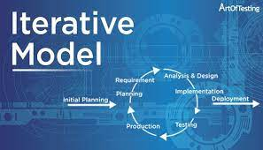
Software Development Life Cycle (SDLC)

Slide 2
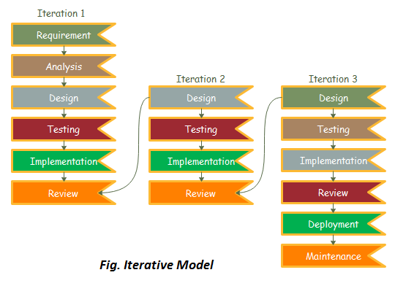
Overview
The iterative process model is a software development life cycle (SDLC) approach in which the initial development work is conducted based on initial requirements that are clearly defined, and subsequent features are added to this base software product through iterations until the final system is completed.

Slide 3
Overview
The various phases of iterative model are as follows:
1. Requirement gathering & analysis: In this phase, requirements are gathered from customers and check by an analyst whether requirements will fulfil or not. Analyst checks that need will achieve within budget or not. After all of this, the software team skips to the next phase.
2. Design: In the design phase, team design the software by the different diagrams like Data Flow diagram, activity diagram, class diagram, state transition diagram, etc.
3. Implementation: In the implementation, requirements are written in the coding language and transformed into computer programs which are called Software.
4. Testing: After completing the coding phase, software testing starts using different test methods. There are many test methods, but the most common are white box, black box, and grey box test methods.

Slide 4
overview
Various phases of iterative model (cont.):
5. Deployment: after completing all the phases, software is deployed to its work environment.
6. Review: in this phase, after the product deployment, review phase is performed to check the behavior and validity of the developed product. And if there are any error found then the process starts again from the requirement gathering.
7. Maintenance: in the maintenance phase, after deployment of the software in the working environment there may be some bugs, some errors or new updates are required. Maintenance involves debugging and new addition options.
When to use the Iterative Model?
When requirements are defined clearly and easy to understand.
When the software application is large.
When there is a requirement of changes in future.

Slide 5
overview
Advantage(pros) of iterative model:
Testing and debugging during smaller iteration is easy.
A parallel development can plan.
It is easily acceptable to ever-changing needs of the project.
Risks are identified and resolved during iteration.
Limited time spent on documentation and extra time on designing.
Disadvantage(cons) of iterative model:
It is not suitable for smaller projects.
More resources may be required.
Design can be changed again and again because of imperfect requirements.
Requirement changes can cause over budget.
Project completion date not confirmed because of changing requirements.

Slide 6
Software Requirement In Iterative SDLC Model Olatunji J. Okesola, Ayodele A. Adebiyi, Ayoade A. Owoade, Oyetunde Adeaga, Oluseyi Adeyemi, And Isaac Odun-ayo
Despite its popularity and strengths over major weaknesses of other models, iterative model is less acceptable by programmers and not widely in use in industry.
Why?
The iterative SDLC model is only appropriate for massive system or software development project only; it is difficult to break a small programming framework into assist little serviceable augmentations/modules.
Costly late-stage issues: while using an iterative model, it is conceivable that an unanticipated issue in plan or hidden framework design will emerge late into the task. Settling this could have conceivably destroying impacts on the time period and expenses of the task. All in all, requiring a lot of future cycles just to determine one issue.

Slide 7
Software Requirement In Iterative SDLC Model
Increased pressure on user engagement: the iterative model regularly requires client engagement all through the whole of the procedure. This is now and again an appalling commitment, since each new emphasis will probably require testing and input from clients with a specific end goal to legitimately assess any vital changes.
Feature creep: not exclusively does the iterative model require client criticism all through the procedure, yet this likewise characteristically implies the task might be liable to undesired element crawl, whereby clients encounter the adjustments in every cycle, and are slanted to continually advance new demands for extra highlights to be added to future forms.
Management complexity: complexity management as a disadvantage, its methodology deals with the analysis and optimization of complexity in enterprises. Effects of complexity pertain to all business processes along the value chain and hence complexity management requires a holistic approach and due to iteration on each build or development, management will be very difficult.

